Slide 1

Statistical Fundamentals:
Using Microsoft Excel for Univariate and Bivariate Analysis
Alfred P. Rovai
The Normal Curve and Univariate Normality
PowerPoint Prepared by
Alfred P. Rovai
Microsoft® Excel® Screen Prints Courtesy of Microsoft Corporation.

Slide 2
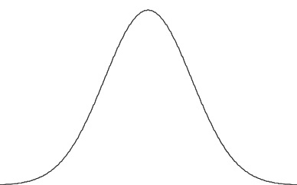
Normal Curve
The normal or Gaussian curve is a family of distributions.
It is a smooth curve and is referred to as a probability density curve for a random variable, x, rather than a frequency curve as one sees in a histogram.
  The area under the graph of a density curve over some interval represents the probability of observing a value of the random variable in that interval.
The family of normal curves has the following characteristics:
  Bell-shaped
  Symmetrical about the mean (the line of symmetry)
  Tails are asymptotic (they approach but do not touch the x-axis)
  The total area under any normal curve is 1 because there is a 100% probability that the curve represents all possible occurrences of the associated event (i.e., normal curves are probability density curves)
  Involve a large number of cases

Slide 3
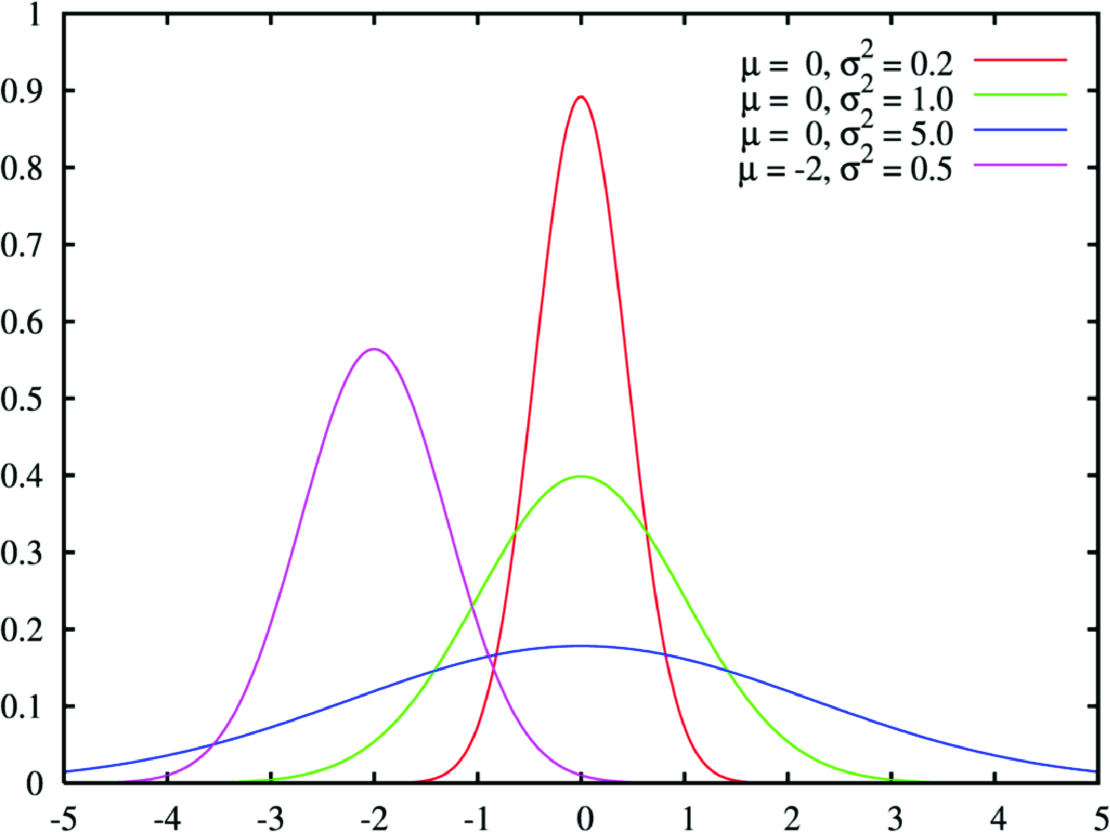
Normal Curve
Various normal curves are shown above. The line of symmetry for each is at μ (the mean). The curve will be peaked (skinnier or leptokurtic) if the σ (standard deviation) is smaller and flatter or platykurtic if it is larger.

Slide 4
Empirical Rule
In a normal distribution (or approximately normal distribution) with mean μ and standard deviation σ, the approximate areas under the normal curve are as follows:
  34.1% of the occurrences will fall between μ and 1σ
  13.6% of the occurrences will fall between 1σ & 2σ
  2.15% of the occurrences will fall between 2σ & 3σ
  If one adds percentages, approximately:
  • 68% of the distribution lies within ± one σ of the mean.
  • 95% of the distribution lies within ± two σ of the mean.
  • 99.7% of the distribution lies within ± three σ of the mean.
  These percentages are known as the empirical rule.
  Example: Given a normal curve (i.e., a density curve), if , μ = 10 and σ = 2, the probability that x is between 8 and 12 is .68.

Slide 5
Chebyshev’s Theorem
The empirical rule does not apply to distributions that are not normal or approximately normal.
For all distributions (including non-normal distributions) Chebyshev’s theorem applies and states:
At least 75% of all scores will fall within 2 standard deviations above and below the mean.
At least 89% of all scores will fall within 3 standard deviations above and below the mean.

Slide 6
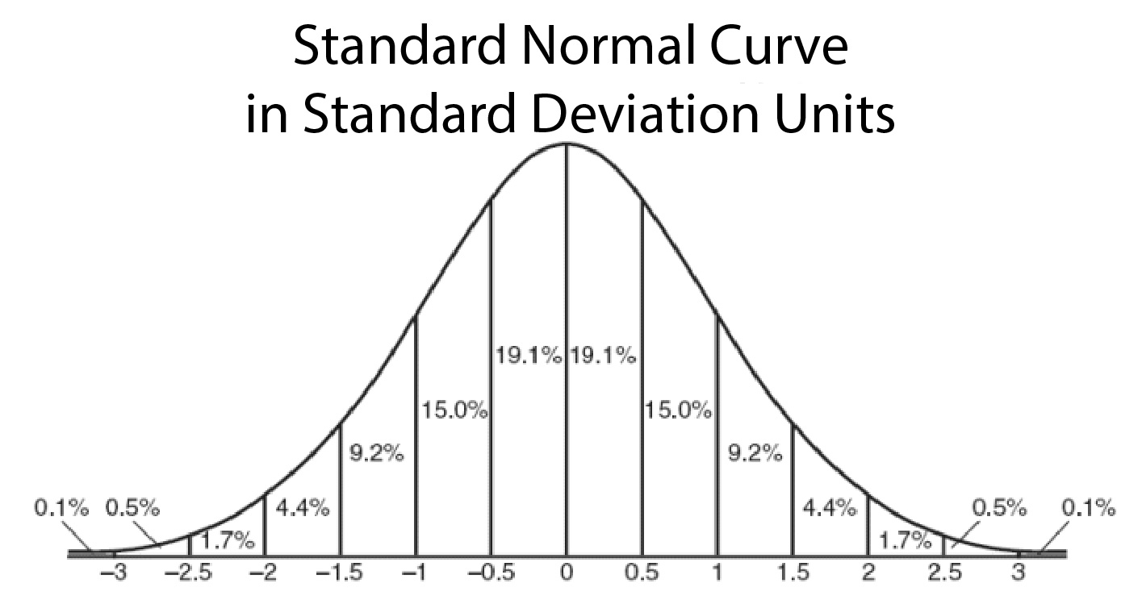
When μ = 0 and σ = 1, the distribution is called the standard normal distribution.
34.1% of the occurrences will fall between 0 and 1
13.6% of the occurrences will fall between 1 & 2
2.15% of the occurrences will fall between 2 & 3

Slide 7
Univariate Normality
Univariate refers to one variable. Normality refers to the shape of a variable’s frequency distribution.
  Symmetrical and shaped like a bell-curve.
Parametric tests assume normality.
  The dependent variable (DV) is approximately normally distributed.
The perfectly normal univariate distribution has standardized kurtosis and skewness statistics equal to zero and mean = mode = median
The assumption of univariate normality does not require a perfectly normal shape.
  Many parametric procedures, e.g., one-way ANOVA, are robust in the face of light to moderate departures from normality.

Slide 8
Procedures
Several tools are available in Excel to evaluate univariate normality
Create a histogram to observe the shape of the distribution and to conduct a preliminary evaluation of normality
Calculate standard coefficients of skewness and kurtosis to determine if the shape of the distribution differs from that of a normal distribution
Calculating the presence of extreme outliers
Use the Kolmogorov-Smirnov test to determine if the data come from a population with a normal distribution

Slide 9
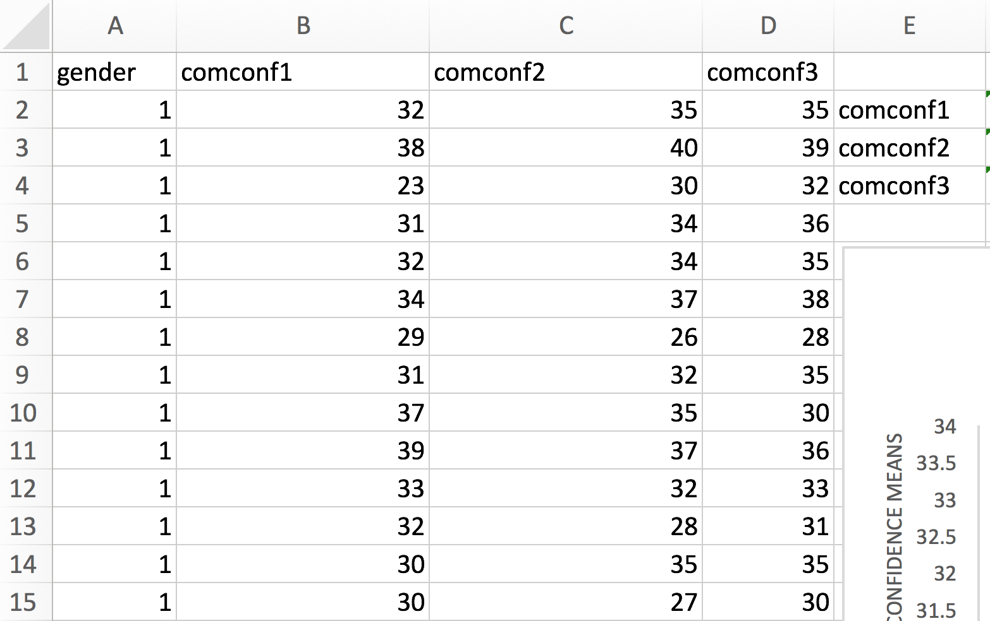
Evaluating Univariate Normality
Open the dataset Computer Anxiety.xlsx.
Click the worksheet Charts tab (at the bottom of the worksheet).
File available at http://www.watertreepress.com/stats
TASK
Evaluate computer confidence posttest (comconf2) for univariate normality.

Slide 10
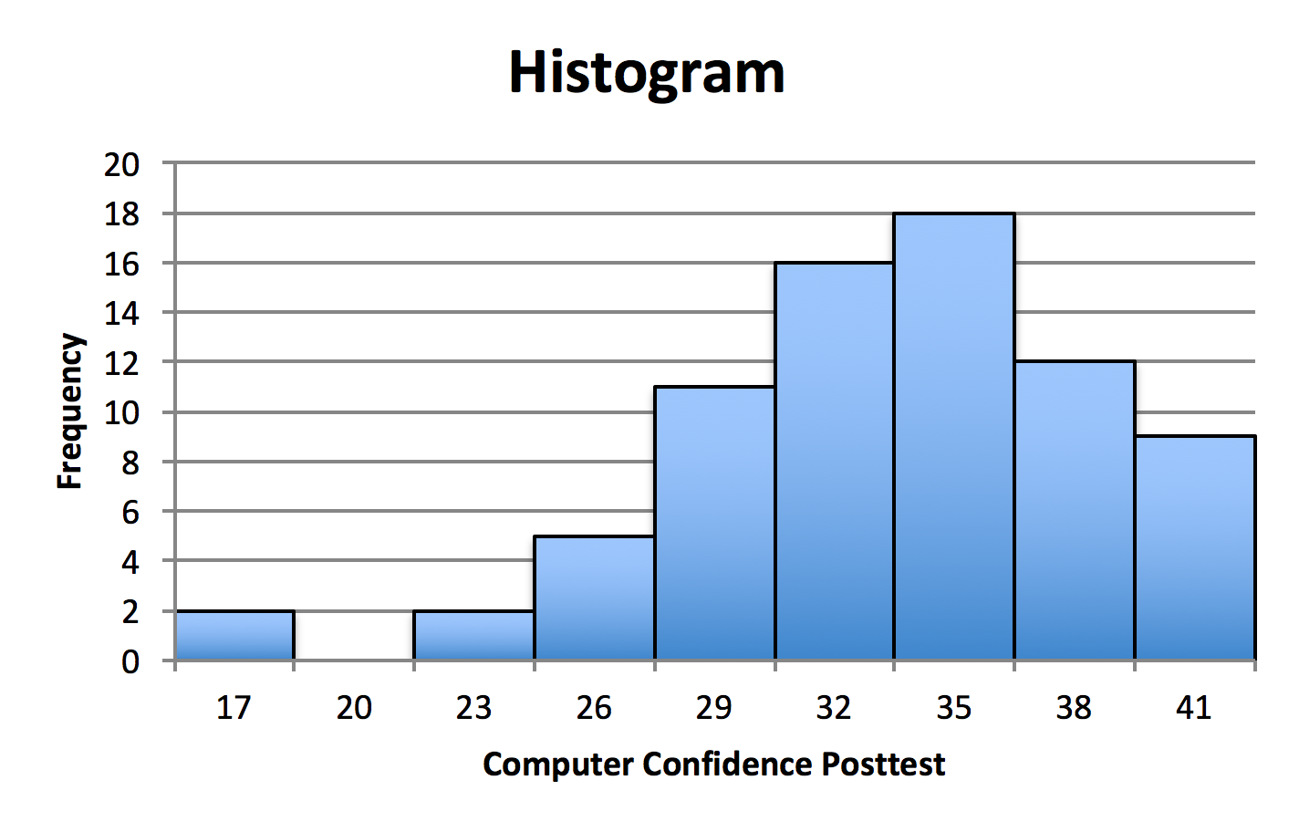
Creating a Histogram
Create a histogram that displays computer confidence posttest (comconf2) in accordance with the procedures described in the textbook and the Histograms Power Point presentation. It reveals a non-symmetric, negatively-skewed shape that approximates a bell shape.
The issue now is to determine whether or not univariate normality is tenable. That is, to determine the extent of the deviations from normality.

Slide 11
Calculating Standard Coefficient of Skewness
Skewness is based on the third moment of the distribution, or the sum of cubic deviations from the mean. It measures deviations from perfect symmetry.
Positive skewness indicates a distribution with a heavier positive (right-hand) tail than a symmetrical distribution.
Negative skewness indicates a distribution with a heavier negative tail.
Excel function:
SKEW(number1,number2,...). Returns the skewness statistic of a distribution.
The standard error of skewness (SES) is a measure of the accuracy of the skewness coefficient and is equal to the standard deviation of the sampling distribution of the statistic.
Normal distributions produce a skewness statistic of approximately zero. The skewness coefficient divided by its standard error can be used as a test of normality. That is, one can reject normality if this statistic is less than –2 or greater than +2.

Slide 12
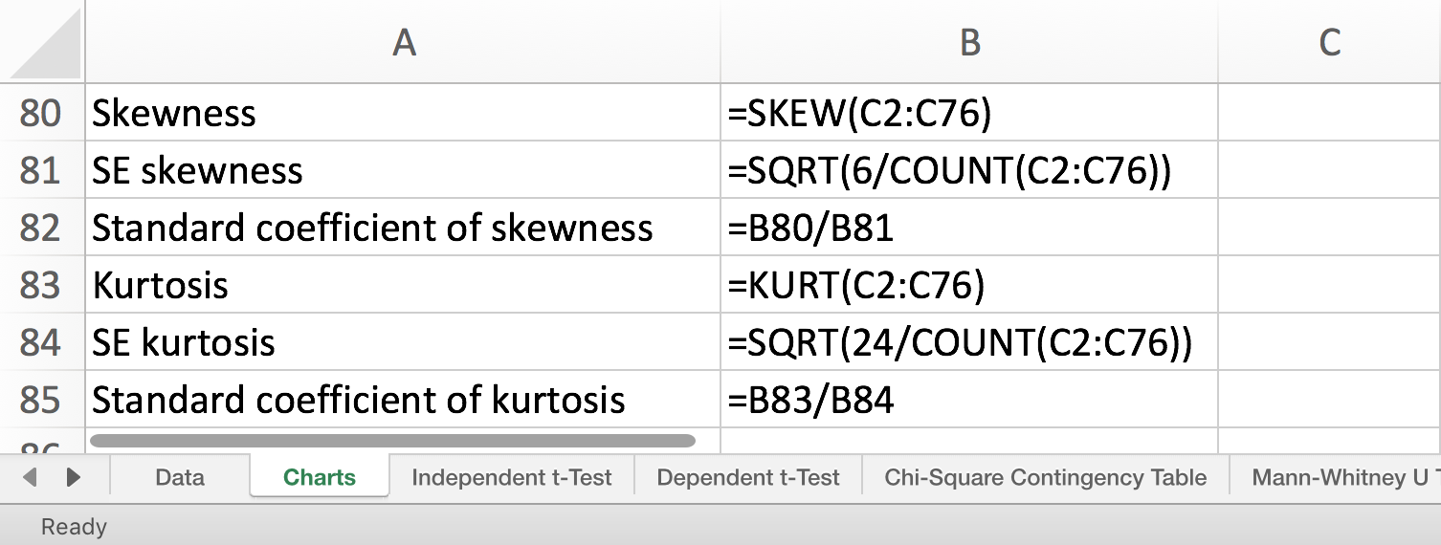
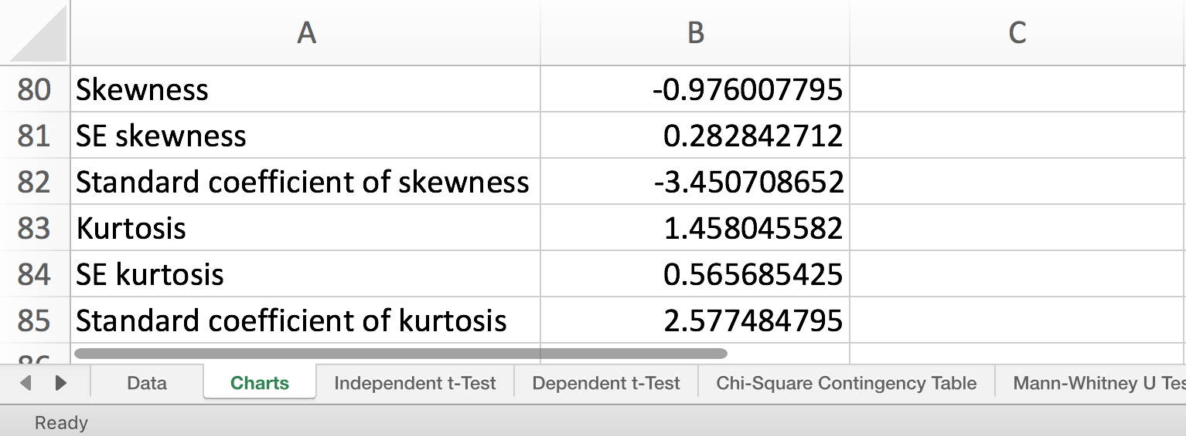
C2:C76 is the address of comconf2 values.
Enter the formulas displayed in cells B80:B82 to calculate the skewness coefficient, the standard error of skewness, and the standard coefficient of skewness using the Charts tab.
The standard coefficient of skewness for the computer confidence posttest data (-3.45) indicates a non-normal, negatively-skewed distribution because it is lower than -2.

Slide 13
Calculating Standard Coefficient of Kurtosis
Kurtosis is derived from the fourth moment (i.e., the sum of quartic deviations). It captures the heaviness or weight of the tails relative to the center of the distribution. Kurtosis measures heavy-tailedness or light-tailedness relative to the normal distribution.
A heavy-tailed distribution has more values in the tails (away from the center of the distribution) than the normal distribution, and will have a negative kurtosis.
A light-tailed distribution has more values in the center (away from the tails of the distribution) than the normal distribution, and will have a positive kurtosis.
Excel function:
KURT(number1,number2,...). Returns the kurtosis statistic of a distribution.
The standard error of kurtosis is a measure of the accuracy of the kurtosis coefficient and is equal to the standard deviation of the sampling distribution of the statistic.
Normal distributions produce a kurtosis statistic of approximately zero. The kurtosis coefficient divided by its standard error can be used as a test of normality. That is, one can reject normality if this ratio is less than –2 or greater than +2.

Slide 14
C2:C76 is the address of comconf2 values.
Enter the formulas displayed in cells B83:B85 to calculate the kurtosis coefficient, the standard error of kurtosis, and the standard coefficient of kurtosis using the Charts tab.
The standard coefficient of kurtosis for the computer confidence posttest data (2.58) indicates a non-normal, peaked (as opposed to flat) distribution because it is higher than 2.

Slide 15
Calculating Extreme Outliers
Outliers are anomalous observations that have extreme values with respect to a single variable.
Reasons for outliers vary from data collection or data entry errors to valid but unusual measurements.
Normal distributions do not include extreme outliers.
It is common to define extreme univariate outliers as cases that are more than three standard deviations above the mean of the variable or less than three standard deviations from the mean.

Slide 16
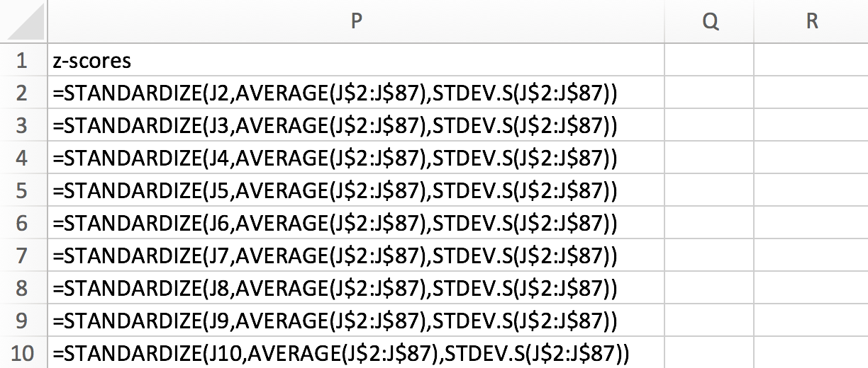
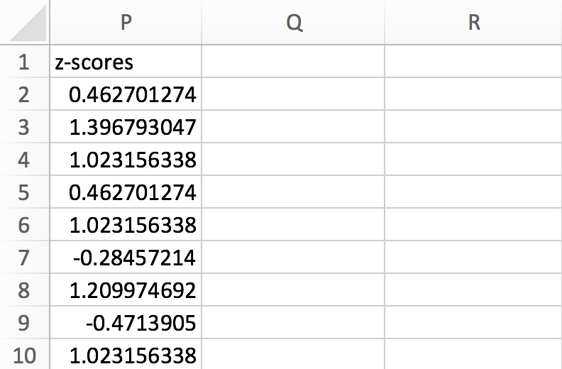
Open the dataset Computer Anxiety 3dEd.xlsx
File available at
http://www.watertreepress.com/stats
Calculate z-scores for variable computer confidence posttest (comconf2). Enter the formula shown on the worksheet in cell P2. Then select cell P2, hold down the Shift key, and click on cell P87 in order to select the range P2:P87. Then use the Excel Edit menu and Fill Down to replicate the formula.
Extreme outliers have z-scores below – 2 and above +2.
Scan the z-scores to note the following extreme low outliers:
Case 61: -3.09
Case 73: -3.46

Slide 17
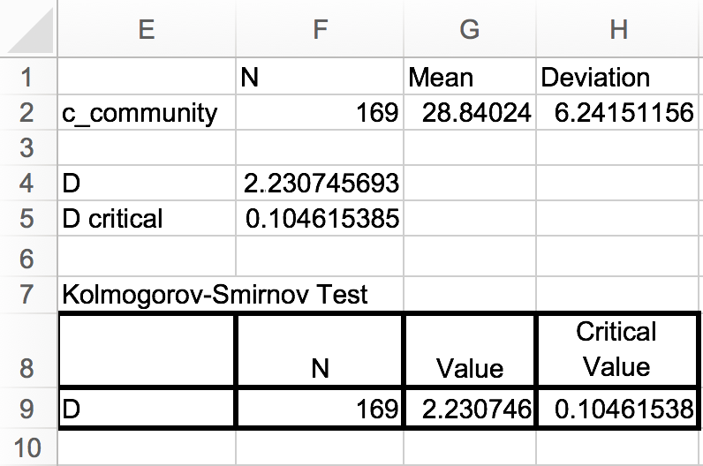
Conducting the Kolmogorov-Smirnov Test
Conduct the Kolmogorov-Smirnov Test in accordance with the procedures described in the textbook in order to evaluate the following null hypothesis:
H_{o}: There is no difference between the distribution of computer confidence posttest data and a normal distribution.
Test results are significant since D (2.23) > the critical value (0.10) at the .05 significance level. Therefore, there is sufficient evidence to reject the null hypothesis and assume normality is not tenable.

Slide 18
Conclusion
Univariate normality is not tenable for posttest computer confidence
The histogram reveals a non-symmetrical negatively-skewed shape
The standard coefficient of skewness of -3.45 indicates a non-normal negatively-skewed distribution
The standard coefficient of kurtosis of 2.58 indicates a non-normal leptokurtic (peaked) distribution
There are two low extreme outliers, z < -2
The Kolmogorov-Smirnov test results are statistically significant at the .05 level indicating a non-normal distribution

Slide 19
The Normal Curve & Univariate Normality
End of Presentation

